Slide 1
Backtracking
From: Design & Analysis of Algorithm
By Anany Levitin

Slide 2
Backtracking: Concept
Backtracking is kind of solving a problem by trial and error. However, it is a well organized trial and error.
We make sure that we never try the same thing twice. We also make sure that if the problem is finite we will eventually try all possibilities (assuming there is enough computing power to try all possibilities).

Slide 3
Backtracking: Concept
The principal idea in backtracking is to construct solutions one component at a time and evaluate such partially constructed candidates as follows.
If a partially constructed solution can be developed further without violating the problem’s constraints, it is done by taking the first remaining legitimate option for the next component.
If there is no legitimate option for the next component, no alternatives for any remaining component need to be considered. In this case, the algorithm backtracks to replace the last component of the partially constructed solution with its next option

Slide 4
Backtracking: Concept
It is convenient to implement this kind of processing by constructing a tree of choices being made, called the state-space tree.
Root of state-space tree represents an initial state before the search for a solution begins.
The nodes of the first level in the tree represent the choices made for the first component of a solution, the nodes of the second level represent the choices for the second component, and so on.
A node in a state-space tree is said to be promising if it corresponds to a partially constructed solution that may still lead to a complete solution; otherwise, it is called nonpromising.
Leaves represent either nonpromising dead ends or complete solutions found by the algorithm.

Slide 5
Backtracking: Concept
In the majority of cases, a states-pace tree for a backtracking algorithm is constructed in the manner of depth-first search.
If the current node is promising, its child is generated by adding the first remaining legitimate option for the next component of a solution, and the processing moves to this child.
If the current node turns out to be nonpromising, the algorithm backtracks to the node’s parent to consider the next possible option for its last component.
if there is no such option, it backtracks one more level up the tree, and so on.
Finally, if the algorithm reaches a complete solution to the
problem, it either stops (if just one solution is required) or continues searching for other possible solutions.

Slide 6
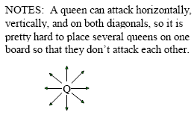
n-Queens Problem
The problem is to place n queens on an n × n chessboard so that no two queens attack each other by being in the same row or in the same column or on the same diagonal.

Slide 7
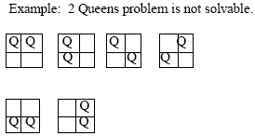
n-Queens Problem
For n = 1, the problem has a trivial solution, and it is easy to see that there is no solution for n = 2 and n = 3.

Slide 8
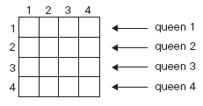
n-Queens Problem
Let us consider the four-queens problem and solve it by the backtracking technique.
Since each of the four queens has to be placed in its own row, all we need to do is to assign a column for each queen on the board presented in following Figure.

Slide 9
Constraint of placing a Queen
Suppose two queens are placed at position (i,j) and (k,l).
They are on same diagonal only if
i-j=k-l or i+j=k+l
First implies j-l=i-k
Second implies j-l=k-i
Therefore two queens lie on the same diagonal if and only if | j-l|= |i-k|

Slide 10
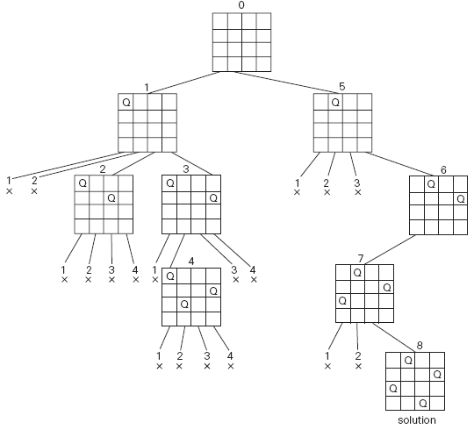
State-space tree of problem by backtracking. X denotes an unsuccessful attempt to place a queen in the indicated column. The numbers above the nodes indicate the order in which the nodes are generated.

Slide 11
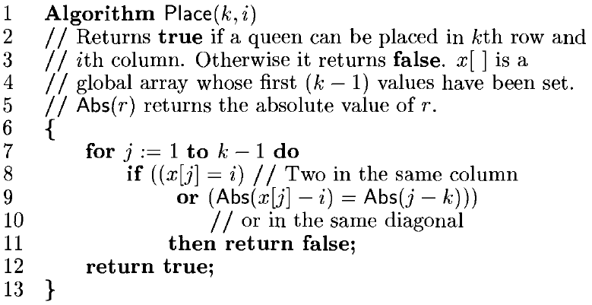
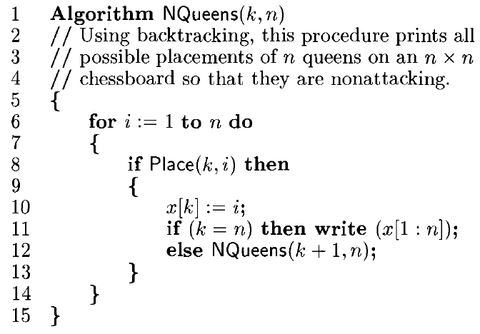
Algorithm for NQueens

Slide 12

Hamiltonian Circuit Problem
It is a path that visits all the graph’s vertices exactly once before returning to the starting vertex.
Let us consider the problem of finding a Hamiltonian circuit in the graph in the Figure
We can assume that if a Hamiltonian circuit exists, it starts at vertex a.
We make vertex a the root of the state-space tree.
The first component of our future solution, if it exists, is a first intermediate vertex of a Hamiltonian circuit to be constructed.
Using the alphabet order to break the three-way tie among the vertices adjacent to a.

Slide 13
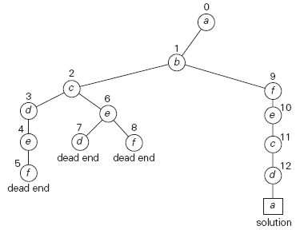
State-space tree for finding a Hamiltonian circuit.
The numbers above the nodes of the tree indicate
the order in which the nodes are generated.

Slide 14
Subset-Sum Problem
In the subset-sum problem, We have to find a subset of a given set A = {a1, . . . , an} of n positive integers whose sum is equal to a given positive integer d.
For example, for A = {1, 2, 5, 6, 8} and d = 9, there are two solutions: {1, 2, 6} and {1, 8}. Of course, some instances of this problem may have no solutions.
It is convenient to sort the set’s elements in increasing order. So, we will assume that a1< a2 < . . . < an.
The state-space tree can be constructed as a binary tree
The root of the tree represents the starting point, with no decisions about the given elements made as yet.
Its left and right children represent, respectively, inclusion and exclusion of a1 in a set being sought.

Slide 15

Subset-Sum Problem
So going to the left from a node of the first level corresponds to inclusion of a2 while going to the right corresponds to its exclusion, and so on.
Thus, a path from the root to a node on the i^{th} level of the tree indicates which of the first i numbers have been included in the subsets represented by that node.
We record the value of s, the sum of these numbers, in the node.
If s is equal to d, we have a solution to the problem. We can either report this result and stop or, if all the solutions need to be found, continue by backtracking to the node’s parent.
If s is not equal to d, we can terminate the node as nonpromising if either of the following two inequalities holds:

Slide 16
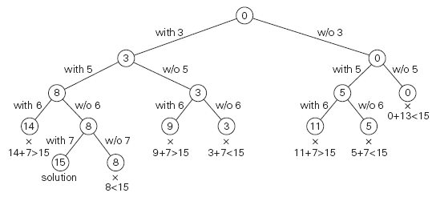
A = {3, 5, 6, 7} and d = 15 of the subset-sum problem.
The number inside a node is the sum of the elements already included in the subsets represented by the node. The inequality below a leaf indicates the reason for its termination.

